Slide 1
Check Independence
Notes:
從 RREF 一眼看出 rank

Slide 2
Checking Independence
Linear independent or not?
A set of n vectors {a₁, a₂, …, a_{n}} is linear dependent
Given a vector set, {a₁, a₂, …, a_{n}}, if there exists any a_{i} that is a linear combination of other vectors
matrix A
Given a vector set, {a₁, a₂, …, a_{n}}, there exists scalars x₁, x₂, …, x_{n}, that are not all zero, such that x₁a₁ + x₂a₂ + ☹ + x_{n}a_{n} = 0.
vector x
$Ax=0$ have non-zero solution

Slide 3
Checking Independence
Linear independent or not?
A
$$\left[\begin{matrix}\begin{matrix}x_{1} \\ x_{2}\end{matrix} \\ \begin{matrix}x_{3} \\ x_{4}\end{matrix}\end{matrix}\right]$$
$$\left[\begin{matrix}\begin{matrix}1 & 1 \\ 2 & 0 \\ 1 & 1\end{matrix} & \begin{matrix}1 & 1 \\ 4 & 2 \\ 1 & 3\end{matrix}\end{matrix}\right]$$
$$=\left[\begin{matrix}0 \\ 0 \\ 0\end{matrix}\right]$$
$Ax=0$ have non-zero solution or not
x₁
x₂
x₃
x₄
x₁
x₂
x₃
x₄
RREF

Slide 4
Checking Independence
x₁
x₂
x₃
x₄
x₁
x₂
x₃
x₄
RREF
dependent
$$x_{1}+2x_{3}=0$$
$$x_{1}=−2x_{3}$$
$$x_{2}−x_{3}=0$$
$$x_{2}=x_{3}$$
$$x_{3} is free$$
$$x_{4}=0$$
$$x_{4}=0$$
$$\left[\begin{matrix}\begin{matrix}x_{1} \\ x_{2}\end{matrix} \\ \begin{matrix}x_{3} \\ x_{4}\end{matrix}\end{matrix}\right]$$
$$=\left[\begin{matrix}\begin{matrix}−2x_{3} \\ x_{3}\end{matrix} \\ \begin{matrix}x_{3} \\ 0\end{matrix}\end{matrix}\right]$$
$$x_{3}\left[\begin{matrix}\begin{matrix}−2 \\ 1\end{matrix} \\ \begin{matrix}1 \\ 0\end{matrix}\end{matrix}\right]$$
setting x₃ = 1
$$\left[\begin{matrix}\begin{matrix}x_{1} \\ x_{2}\end{matrix} \\ \begin{matrix}x_{3} \\ x_{4}\end{matrix}\end{matrix}\right]=\left[\begin{matrix}\begin{matrix}−2 \\ 1\end{matrix} \\ \begin{matrix}1 \\ 0\end{matrix}\end{matrix}\right]$$
$$=$$

Slide 5
Checking Independence
Linear independent or not?
其實這題用看的就知道答案了!
A set of n vectors {a₁, a₂, …, a_{n}} is linear dependent
Given a vector set, {a₁, a₂, …, a_{n}}, if there exists any a_{i} that is a linear combination of other vectors
matrix A
Given a vector set, {a₁, a₂, …, a_{n}}, there exists scalars x₁, x₂, …, x_{n}, that are not all zero, such that x₁a₁ + x₂a₂ + ☹ + x_{n}a_{n} = 0.
vector x
$Ax=0$ have non-zero solution

Slide 6
Column Correspondence Theorem
pivot columns
Leading entries
linear independent
linear independent
The pivot columns are linear independent.

Slide 7
Column Correspondence Theorem
pivot columns
Leading entries
a₂ = 2a₁
a₅ = −a₁+a₄
a₆ = −5a₁−3a₃+2a₄
r₂ = 2r₁
r₅ = −r₁+r₄
r₆ = −5r₁−3r₃+2r₄
The non-pivot columns are the linear combination of the previous pivot columns.

Slide 8
Independent
Dependent
All columns are independent
The column is the linear combination of left pivot column.
Every column is a pivot column
If a column is not pivot
Every column in RREF(A) is standard vector.

Slide 9
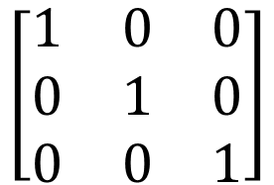
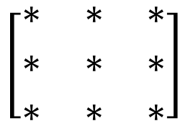
Independent
3X3
All columns are independent
$$\left[\begin{matrix}∗ & ∗ & ∗ \\ ∗ & ∗ & ∗ \\ ∗ & ∗ & ∗\end{matrix}\right]$$
Columns are linear independent
Every column is a pivot column
RREF
Every column in RREF(A) is standard vector.
$$\left[\begin{matrix}1 & 0 & 0 \\ 0 & 1 & 0 \\ 0 & 0 & 1\end{matrix}\right]$$
Identity matrix

Slide 10

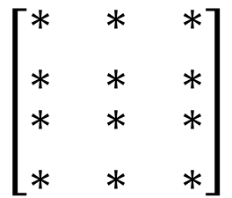
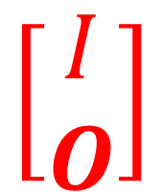
Independent
4X3
$$\left[\begin{matrix}\begin{matrix}∗ & ∗ & ∗ \\ ∗ & ∗ & ∗\end{matrix} \\ \begin{matrix}∗ & ∗ & ∗ \\ ∗ & ∗ & ∗\end{matrix}\end{matrix}\right]$$
All columns are independent
Columns are linear independent
Every column is a pivot column
RREF
Every column in RREF(A) is standard vector.
$$\left[\begin{matrix}\begin{matrix}1 & 0 & 0 \\ 0 & 1 & 0\end{matrix} \\ \begin{matrix}0 & 0 & 1 \\ 0 & 0 & 0\end{matrix}\end{matrix}\right]$$
$$\left[\begin{matrix}I \\ O\end{matrix}\right]$$

Slide 11
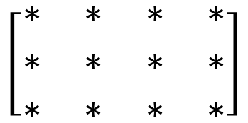

Independent
3X4
All columns are independent
$$\left[\begin{matrix}\begin{matrix}∗ & ∗ \\ ∗ & ∗ \\ ∗ & ∗\end{matrix} & \begin{matrix}∗ & ∗ \\ ∗ & ∗ \\ ∗ & ∗\end{matrix}\end{matrix}\right]$$
Columns are linear independent
Every column is a pivot column
RREF
Cannot be a pivot column
Every column in RREF(A) is standard vector.
$$\left[\begin{matrix}\begin{matrix}1 & 0 \\ 0 & 1 \\ 0 & 0\end{matrix} & \begin{matrix}0 & ∗ \\ 0 & ∗ \\ 1 & ∗\end{matrix}\end{matrix}\right]$$

Slide 12

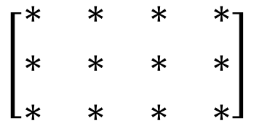
Independent
$$\left[\begin{matrix}1 & 1 \\ 2 & 2 \\ 3 & 3\end{matrix}\right]$$
dependent
因為太胖了，自己走不動
$$\left[\begin{matrix}\begin{matrix}∗ & ∗ \\ ∗ & ∗ \\ ∗ & ∗\end{matrix} & \begin{matrix}∗ & ∗ \\ ∗ & ∗ \\ ∗ & ∗\end{matrix}\end{matrix}\right]$$
The columns are dependent
(矮胖型)
Dependent or Independent?
dependent
More than 3 vectors in R³ must be dependent.
More than m vectors in R^{m} must be dependent.
Notes:
Can I explain this in an intuitive way?
Independent – Intuition

